Slide 1
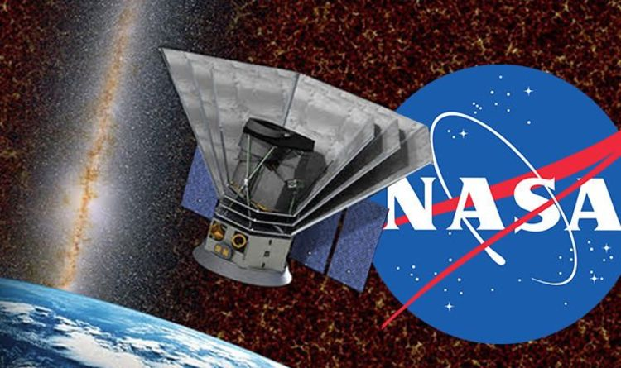
SPHEREx: Scanning the Skies
Julian Mena, Dr. Philip Mauskopf

Slide 2

Outline
Abstract
Introduction
The SPHEREx Satellite
What are Quaternions?
Quaternions in SPHEREx
Projected Results
Future Implications
Acknowledgements
References

Slide 3
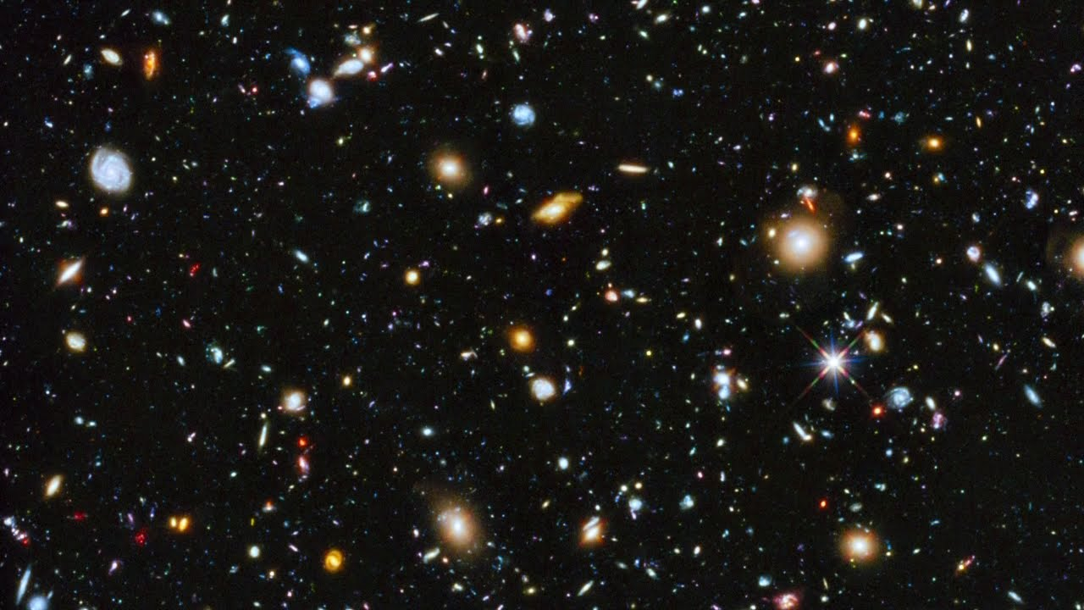
Abstract
Space telescopes that orbit the Earth have been key in space exploration, and have discovered things that were once considered science fiction. These space telescopes, however, have only been able to look at one small part of the sky at a time, leaving much of the sky unobserved. The SPHEREx Satellite Telescope seeks to solve this issue. SPHEREx will orbit the Earth longitudinally with set movement constraints in order to observe the entire sky. This will be accomplished by writing a routine in Python, and using quaternions, a form of 4D algebra, to act as a coordinate system so that the satellite can move about the Earth. Because this mission does not launch until December 2023, there is not any data to share. However, current projections predict about 97% sky observance by the satellite telescope. With this increase in observed sky, countless new discoveries are sure to follow.

Slide 4
Introduction
SPHEREx is a satellite telescope set to launch in December 2023
  Coding development is still in the early stages
SPHEREx has a mission of observing as much of the sky as possible, and downlinking the data it collected to certain data centers as it passes by
Personal role to help write, edit, and test Python routines for the Satellite Telescope
  Key project: quaternion system (originally written in IDL by Dr. Mauskopf)
    “Pythonized” by Dr. Sean Bryan

Slide 5
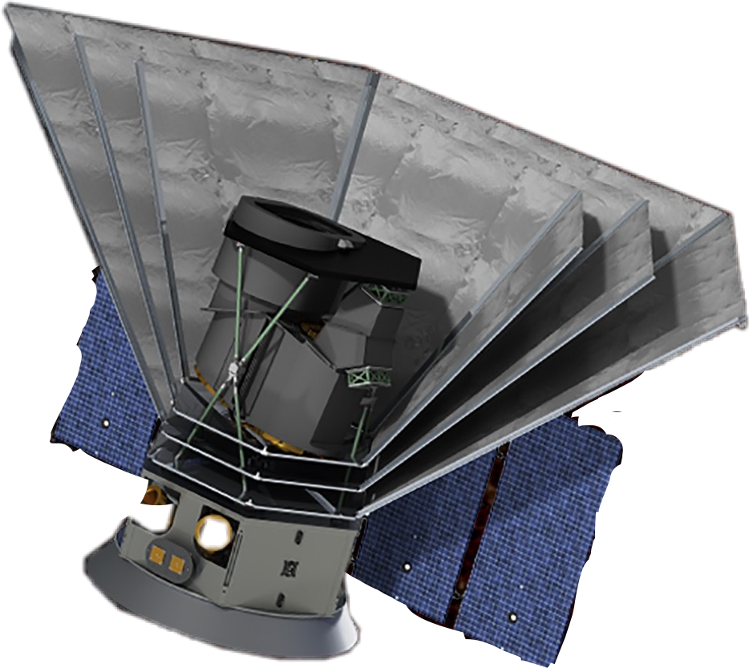
The SPHEREx Satellite
Telescope with LVF
Spectrometer
Photon Shields
Key Features
Small and compact satellite
Short mission (2-3 years)
Can observe across multiple light spectrums
No moving parts
Solar Panels

Slide 6
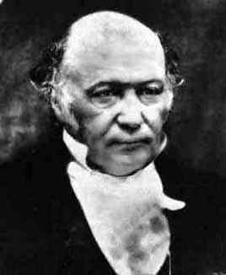
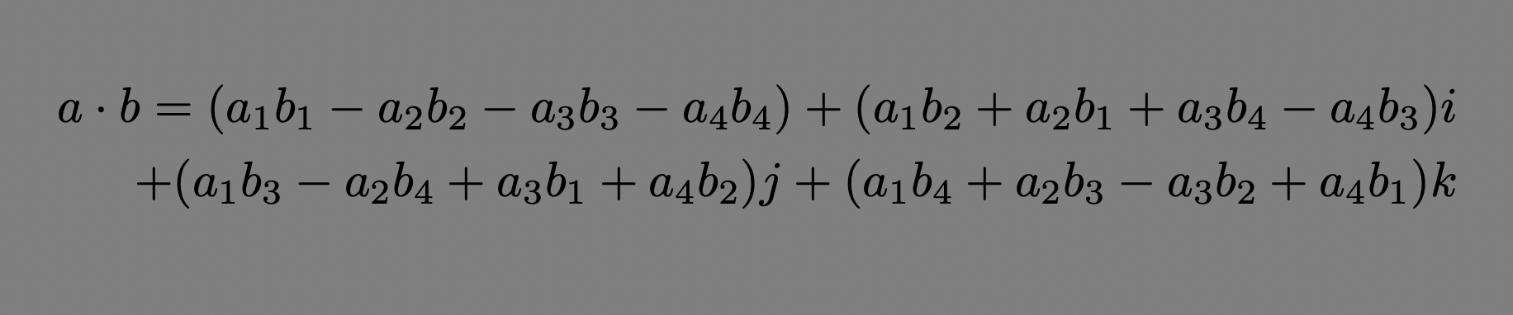
What Are Quaternions?
Invented by William Rowan Hamilton on October 16, 1843
A version of 4-D Algebra
Not widely used in math due to complexity, but very popular to use in coding
William Rowan Hamilton
Quaternion Multiplication

Slide 7
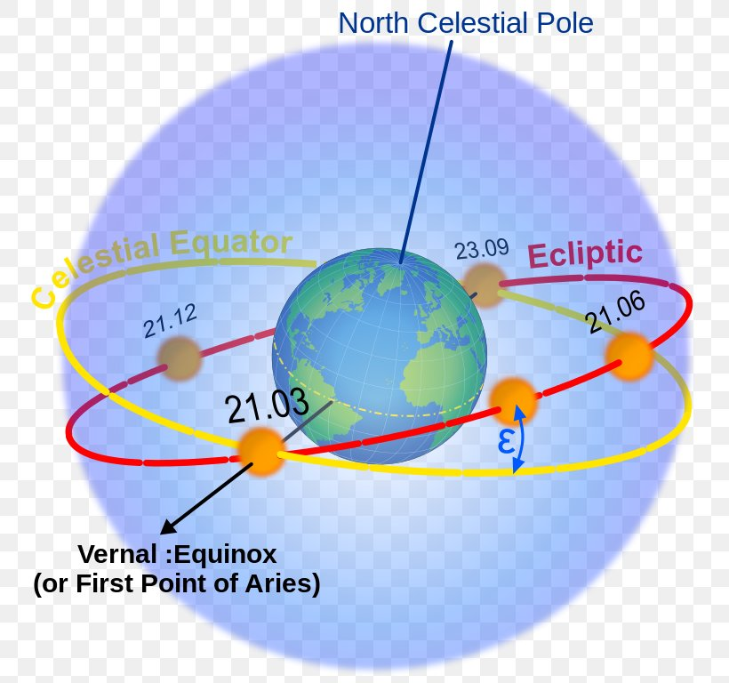
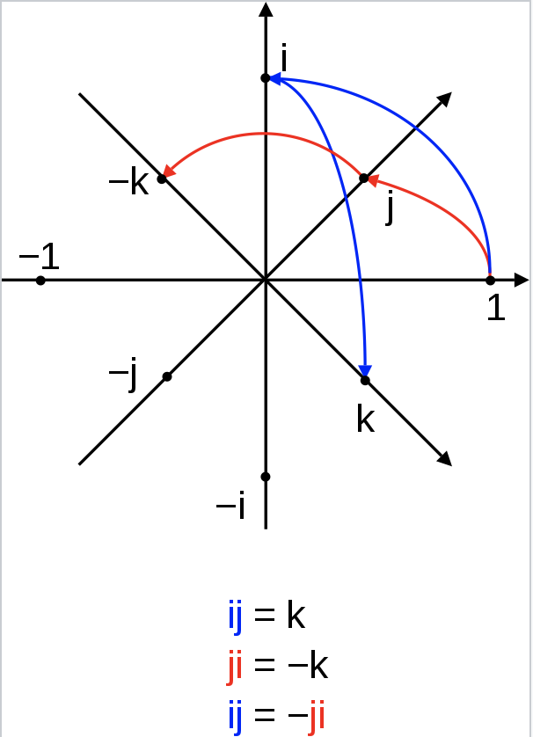
Quaternions in SPHEREx
Used in SPHEREx schedule coding as a method of transforming coordinates across the ecliptic plane’s “axes” to let the satellite know where to go
Take up less space in a coding program than rotation matrices do. Preferable due to decreased run time for satellite slew schedule programs
The Celestial and Ecliptic Planes
The Celestial and Ecliptic Planes
Visual Interpretation of Quaternion Transformations

Slide 8
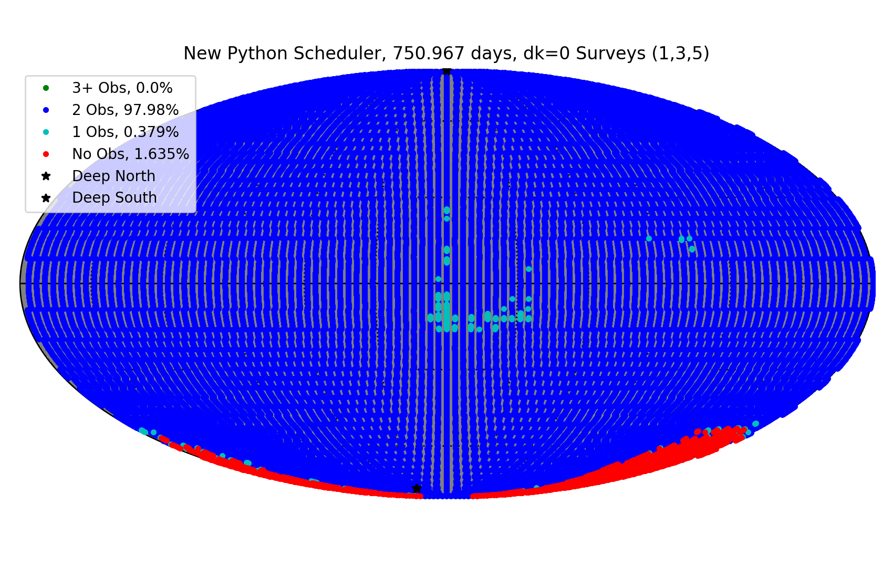
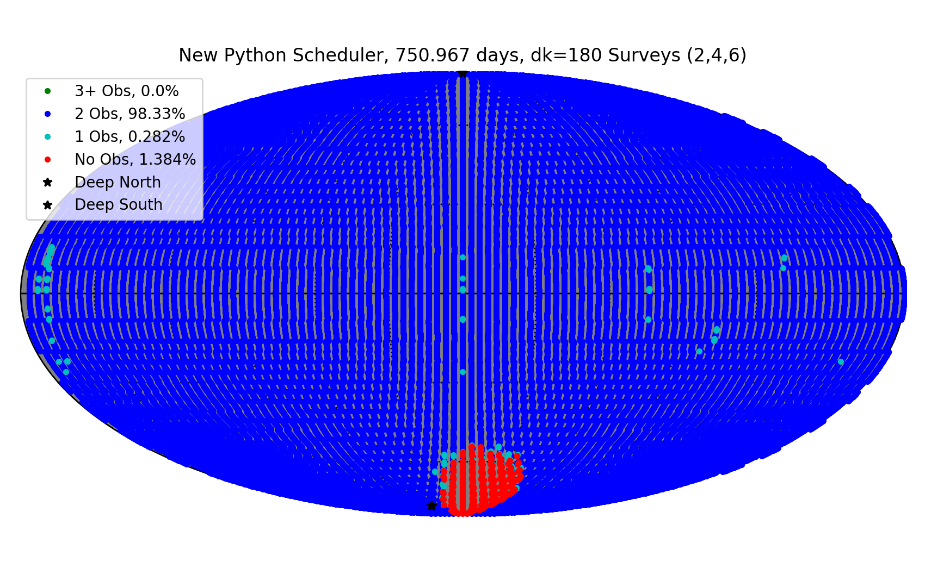
Projected Results
We predict 98%-99% observability for the SPHEREx mission with current slew schedule outputs
Odd-numbered Surveys
Even-numbered Surveys

Slide 9
Future Implications
The data collected by the SPHEREx mission may lead to:
Future exo-planet discoveries
More information about the beginning of the universe
What SPHEREx already brings to the table:
A new and innovative way to explore our universe while staying (sort of) close to home
Notes:
The possibility of finding another earth-like planet
SPHEREx will use its spectrometer to gather images from the beginning stage of galaxy formation

Slide 10
Acknowledgements
I would like to take a moment to acknowledge:
Dr. Philip Mauskopf
Dr. Sean Bryan
Pao-Yu Wang
Cody Roberson
The NASA Space Grant and NASA Space Grant Staff
The JPL staff working on the SPHEREx Project

Slide 11
References
Caltech. (n.d.). SPHEREx Science. Retrieved March 24, 2020, from https://spherex.caltech.edu/Science.html
Desk, I. T. W. (2019, February 16). Origin of the Universe: NASA to launch new telescope in 2023 to investigate the universe. Retrieved March 24, 2020, from https://www.indiatoday.in/science/story/nasa-new-mission-spherex-telescope-origins-of-universe-1457595-2019-02-16
FAVPNG.com. (n.d.). Earth Ecliptic Celestial Equator Plane Celestial Sphere - PNG - Download Free. Retrieved March 30, 2020, from https://favpng.com/png_view/earth-earth-ecliptic-celestial-equator-plane-celestial-sphere-png/fFL0eivd
Fish, T. (2019, February 14). NASA announce SPHEREx mission to see 'fingerprints' of BIG BANG. Retrieved March 26, 2020, from https://www.express.co.uk/news/science/1087295/nasa-spherex-mission-big-bang-universe-origin-space-news
Hamilton Portraits. (n.d.). Retrieved March 24, 2020, from http://mathshistory.st-andrews.ac.uk/PictDisplay/Hamilton.html
Information@eso.org, NASA, & Ellis, R. (2012). The Hubble Ultra Deep Field 2012. Retrieved March 24, 2020, from https://www.spacetelescope.org/images/heic1219b/
mathshistory.st-andrews.ac.uk. (n.d.). Sir William Rowan Hamilton. Retrieved March 30, 2020, from http://mathshistory.st-andrews.ac.uk/Biographies/Hamilton.html
NASA Jet Propulsion Laboratory. (n.d.). SPHEREx. Retrieved March 24, 2020, from https://www.jpl.nasa.gov/missions/spherex/
SPHEREx Science Team (n.d.). SPHEREx: An All-Sky Spectral Survey. Retrieved March 26, 2020, from https://cor.gsfc.nasa.gov/copag/AAS_Jan2018/spherex_aasPAGs_2018_v1.pdf
Quaternion. (2020, March 31). Retrieved from https://en.wikipedia.org/wiki/Quaternion#/media/File:Quaternion_2.svg
WolframMathworld. (n.d.). Quaternion. Retrieved March 29, 2020, from https://mathworld.wolfram.com/Quaternion.html

Slide 12
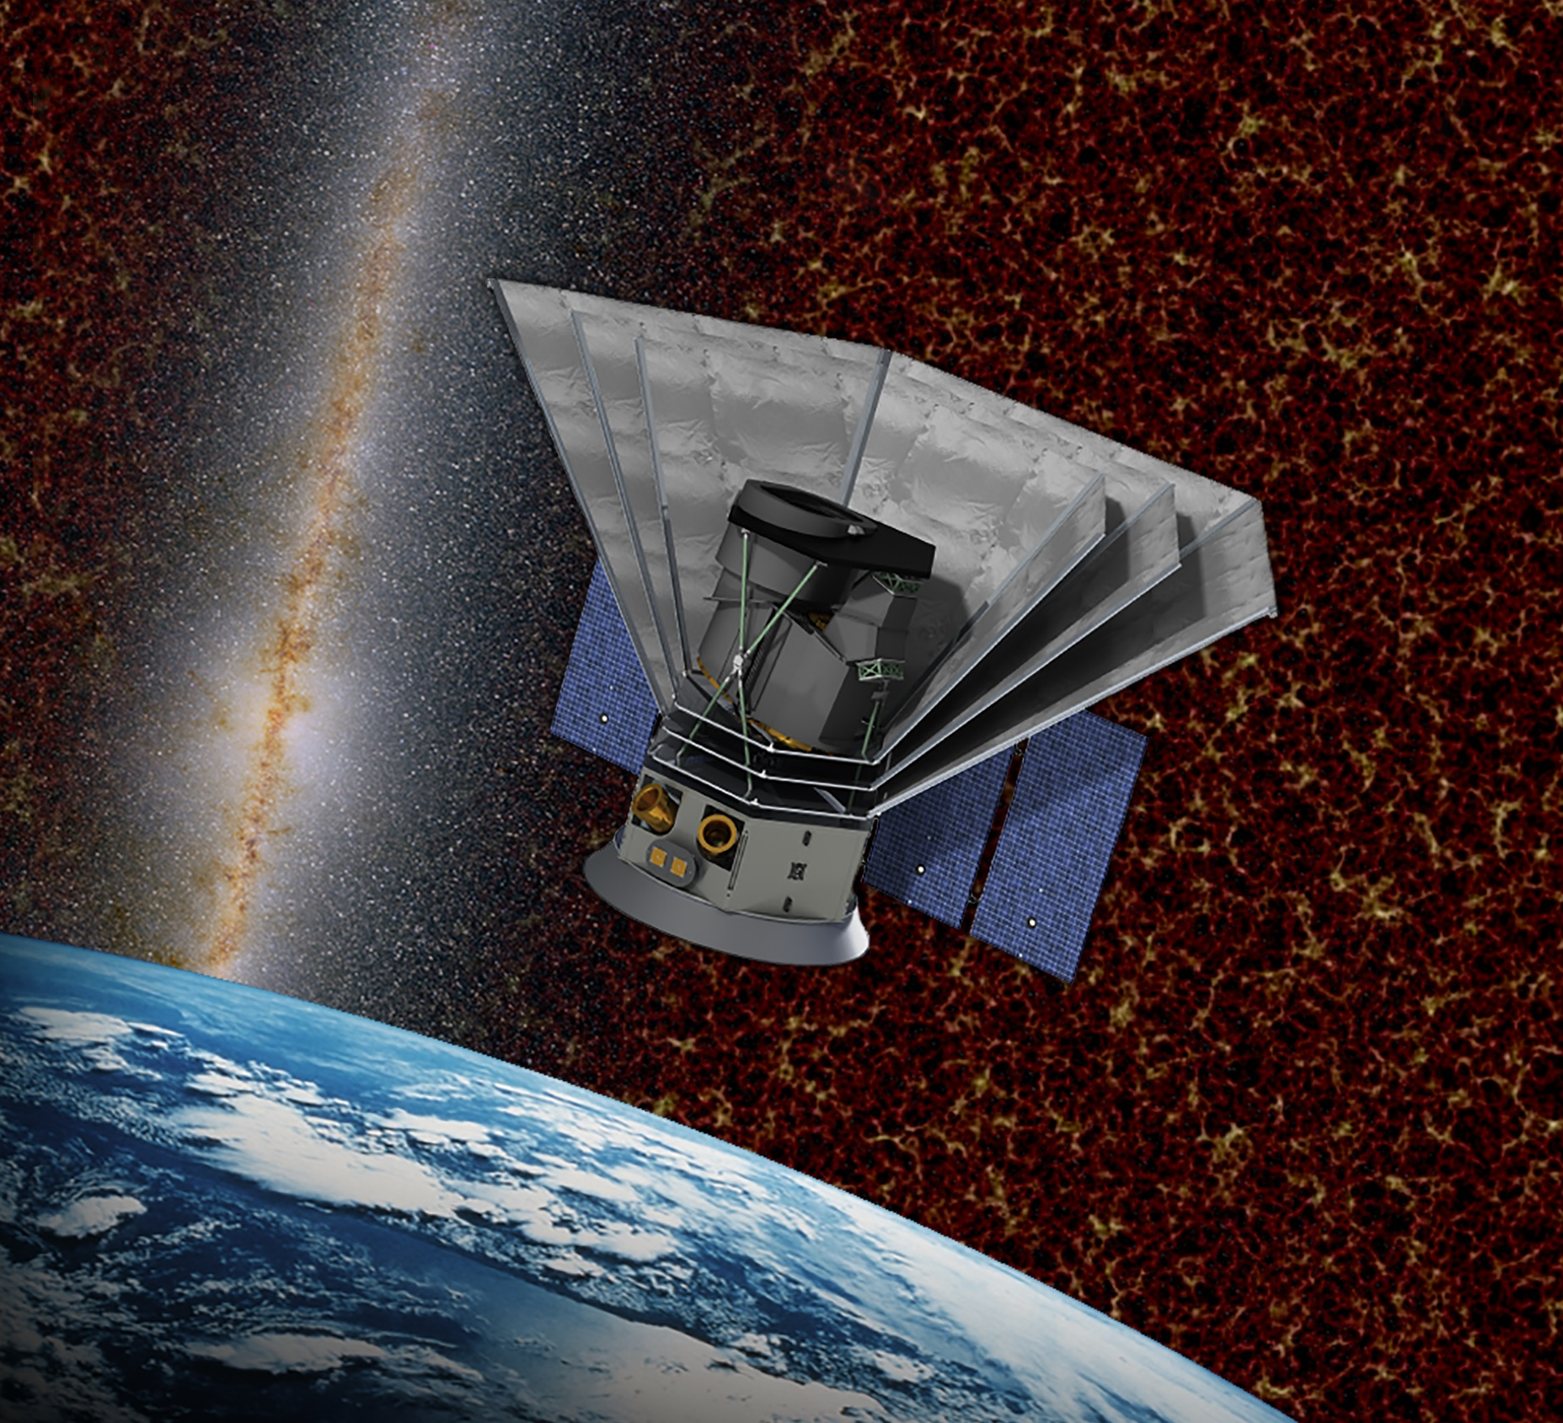
Questions?

